Slide 1
Unit 4: We have English!
Grade 3
Lesson 1

Slide 2
Listen, point
and repeat!

Slide 4
Listen and chant

Slide 6
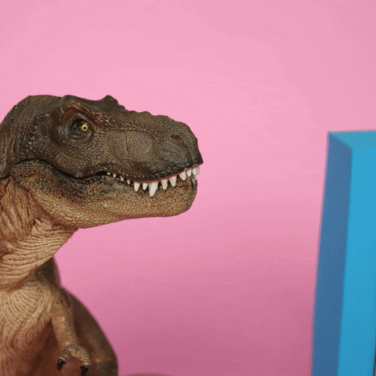
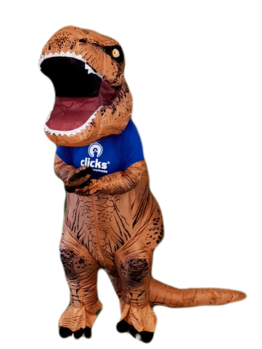
It’s time for a game!

Slide 7
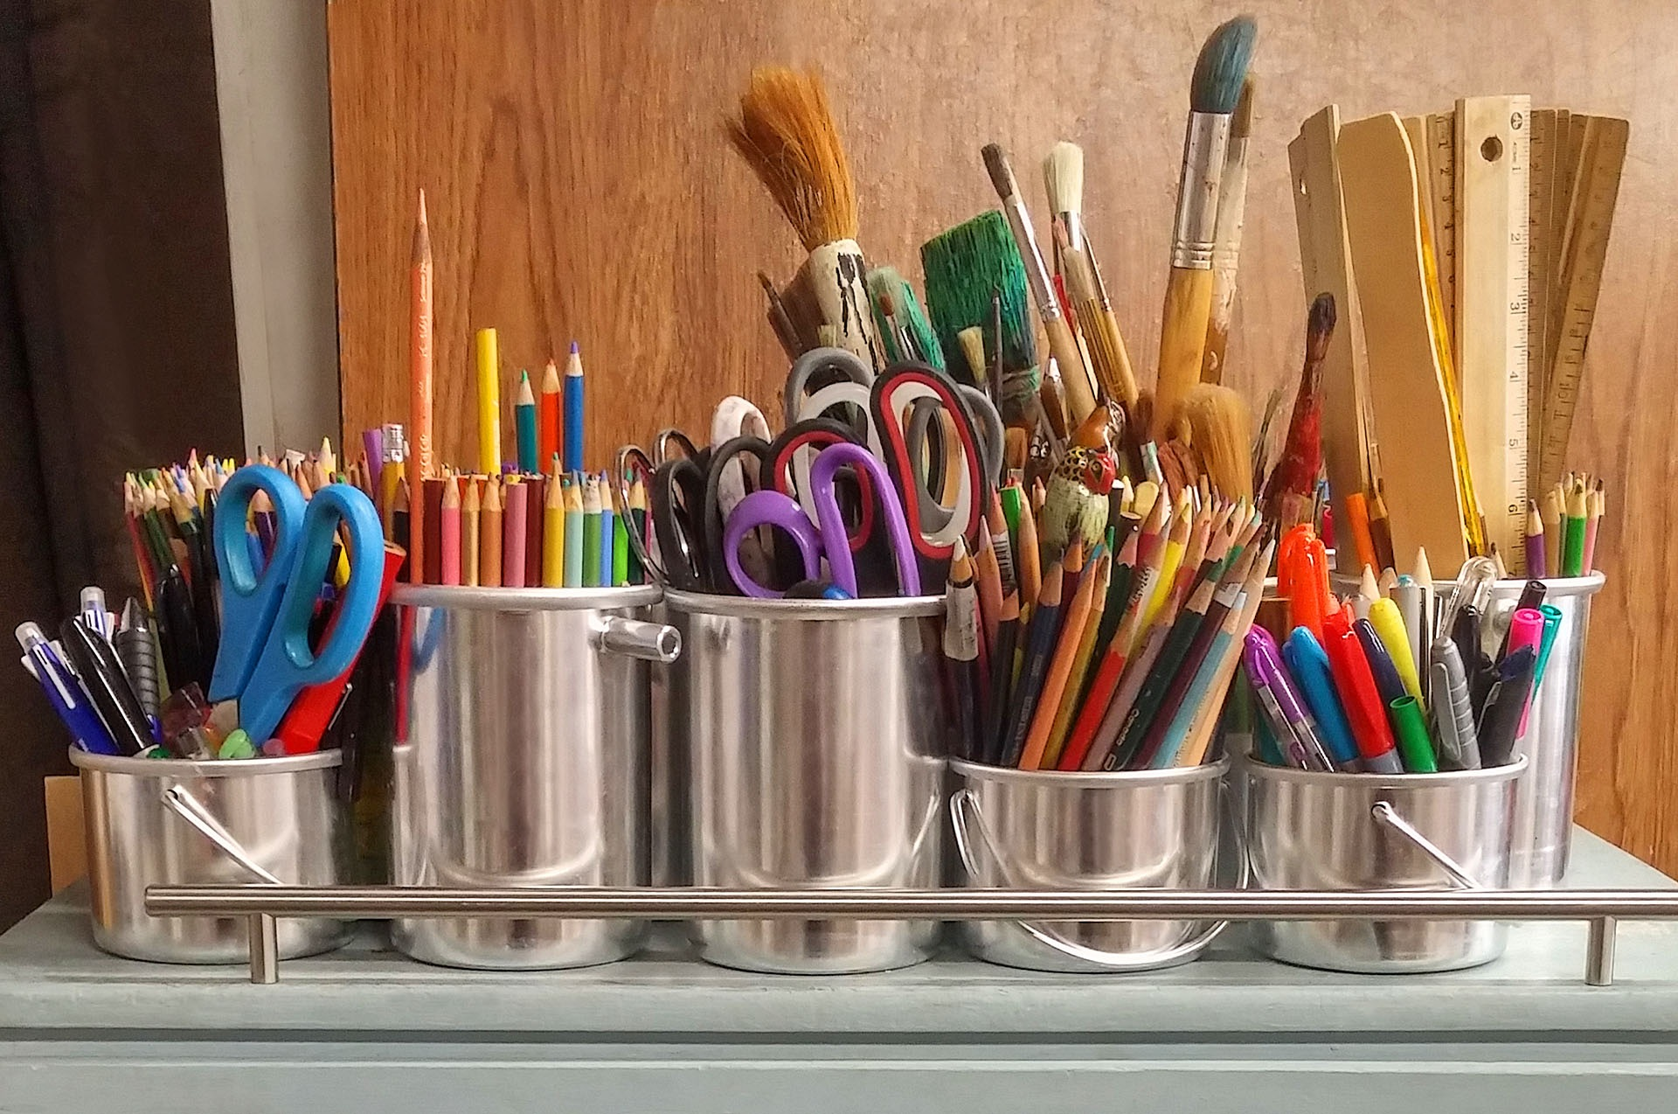
art

Slide 8
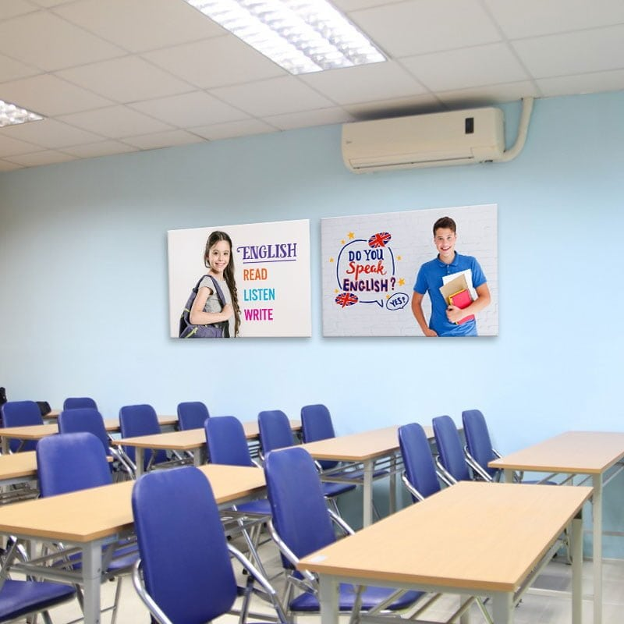
English

Slide 9
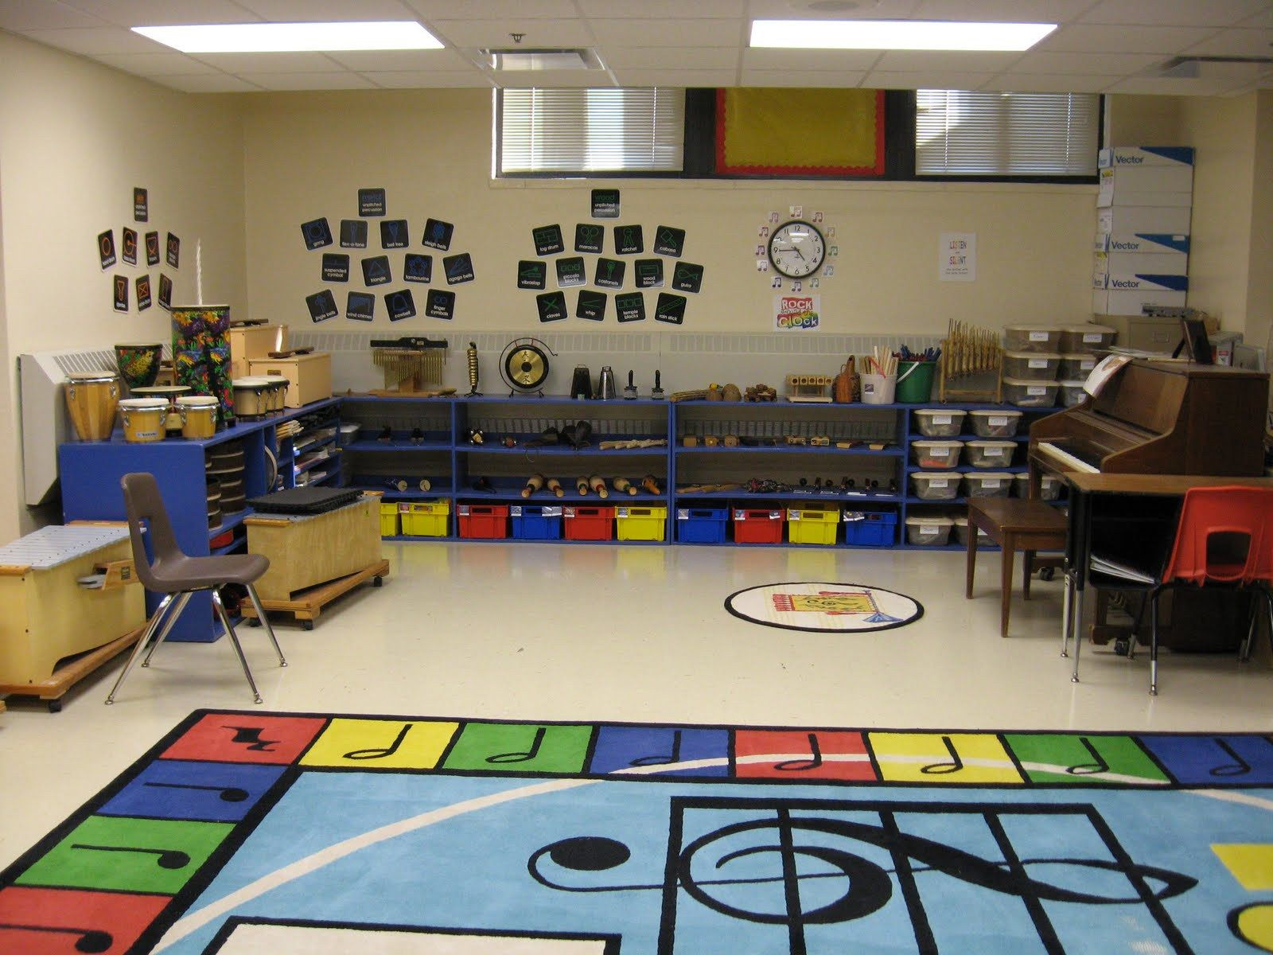
music

Slide 10
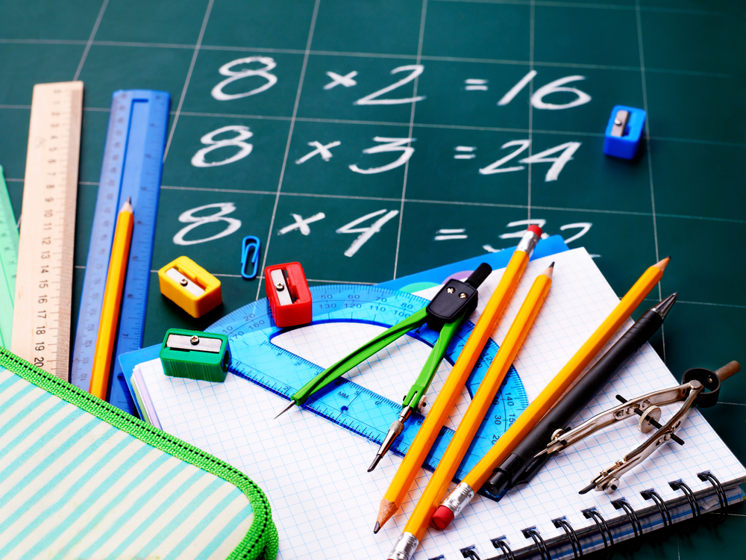
math

Slide 11
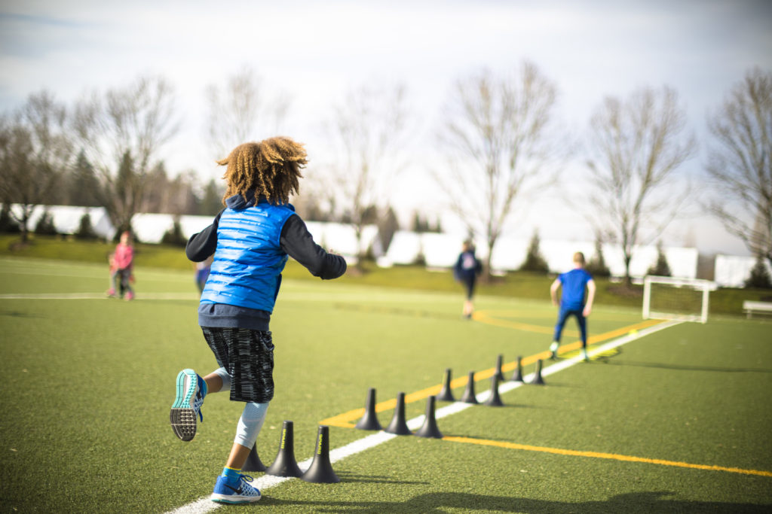
P.E

Slide 12
Tasks
Draw your favorite subject, then tell your friend about it!

Slide 15
Unit 4: We have English!
Grade 3
Lesson 2

Slide 16
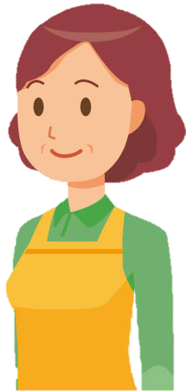
Don’t forget your ruler.
What does she have tomorrow?
Yes mom!
Math
Music

Slide 17
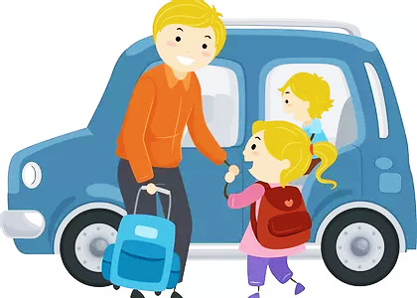
How was your day?
What did she have today?
I had fun playing ball dad.
English
P.E

Slide 18
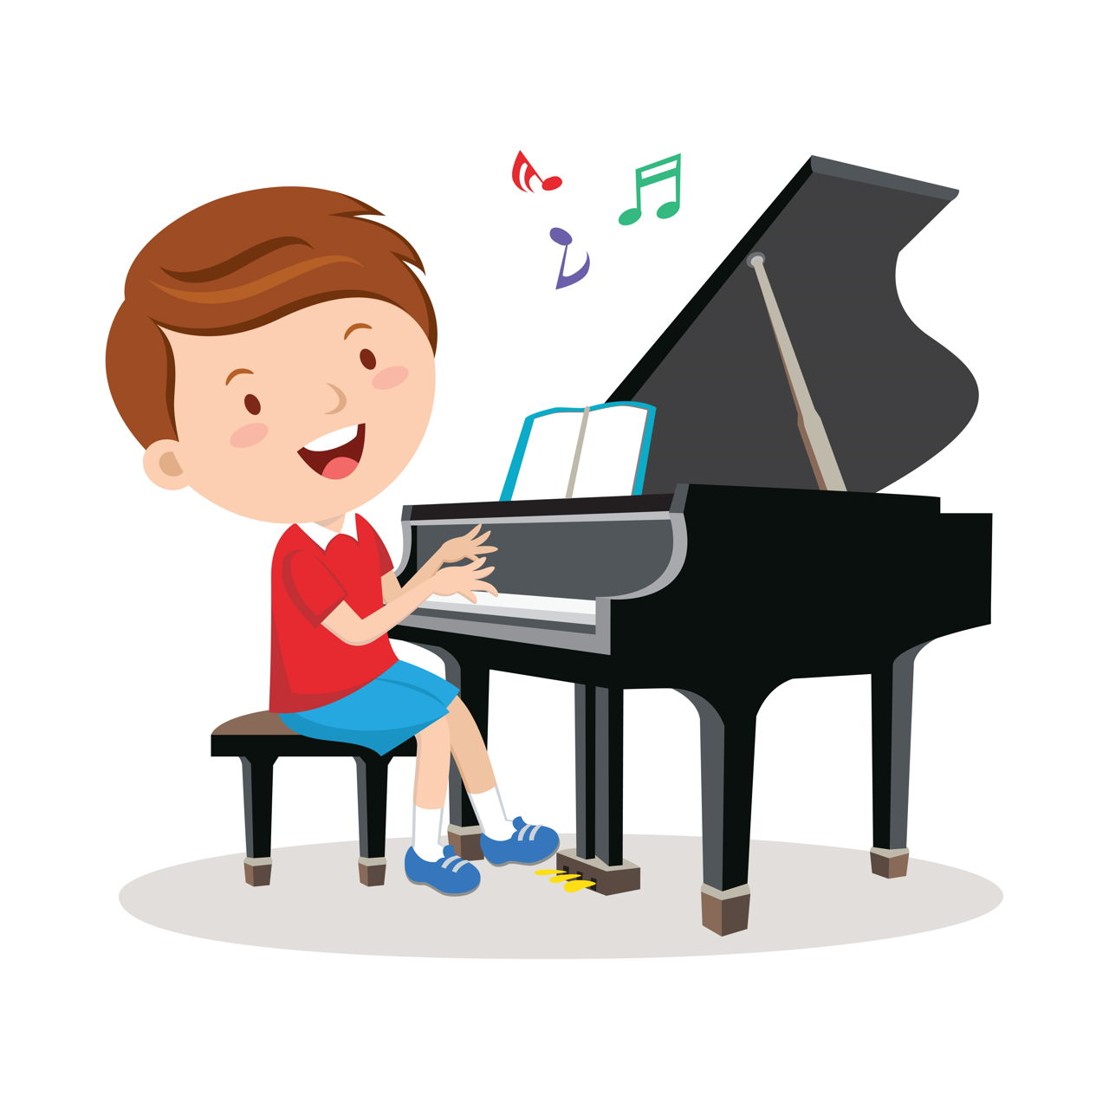
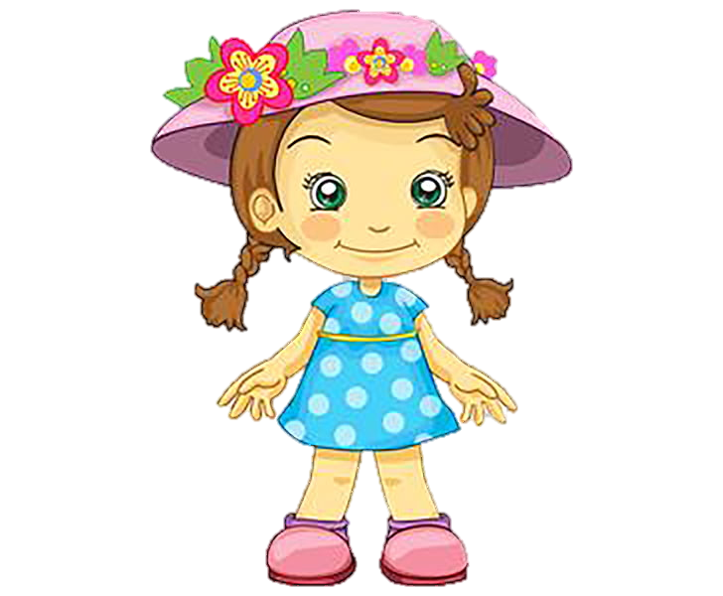
I’m practicing for tomorrow test
What does he have tomorrow?
What are you doing?
Art
Music

Slide 19
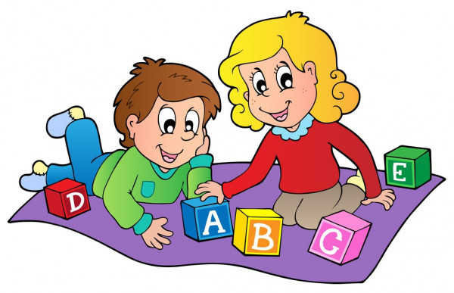
We learned these letters today.
What did they have today?
Yes, we did.
English
P.E

Slide 20
Let me help with tomorrow homework.
What does he have tomorrow?
Thanks, mom!
Math
Art

Slide 21
Listen point and repeat!

Slide 23
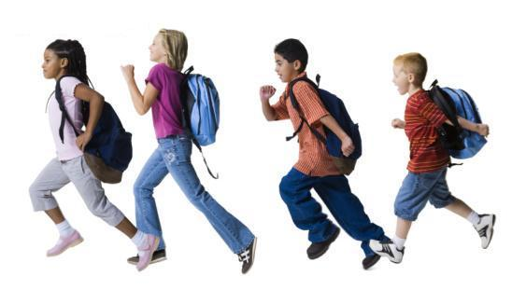
These are our schoolbags.
We have schoolbags.
we
- our

Slide 24
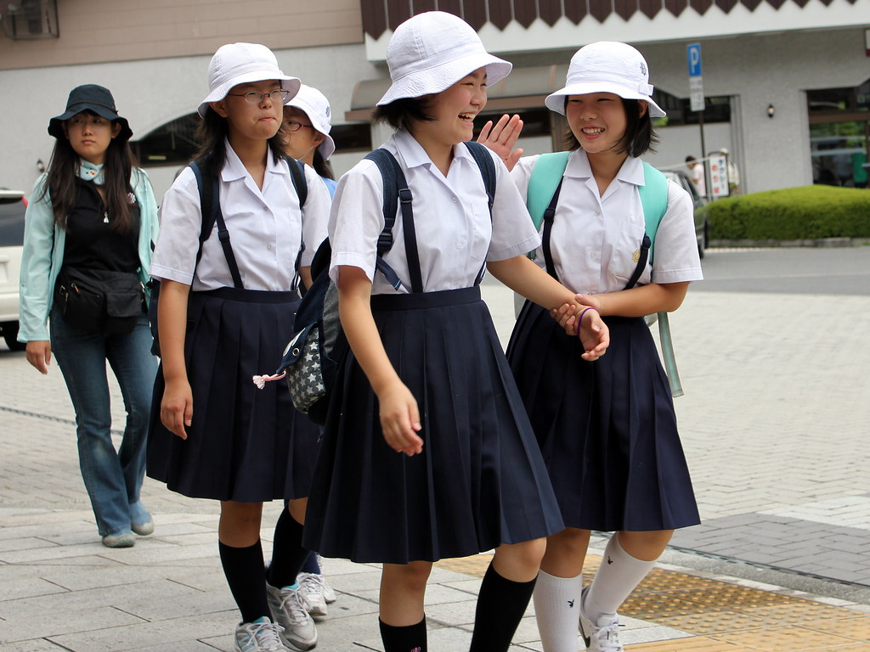
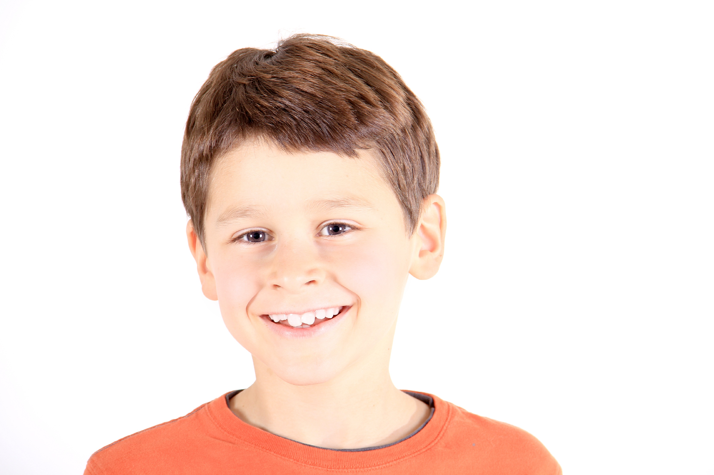
They wear their hats.
They have hats.
they
- their

Slide 25
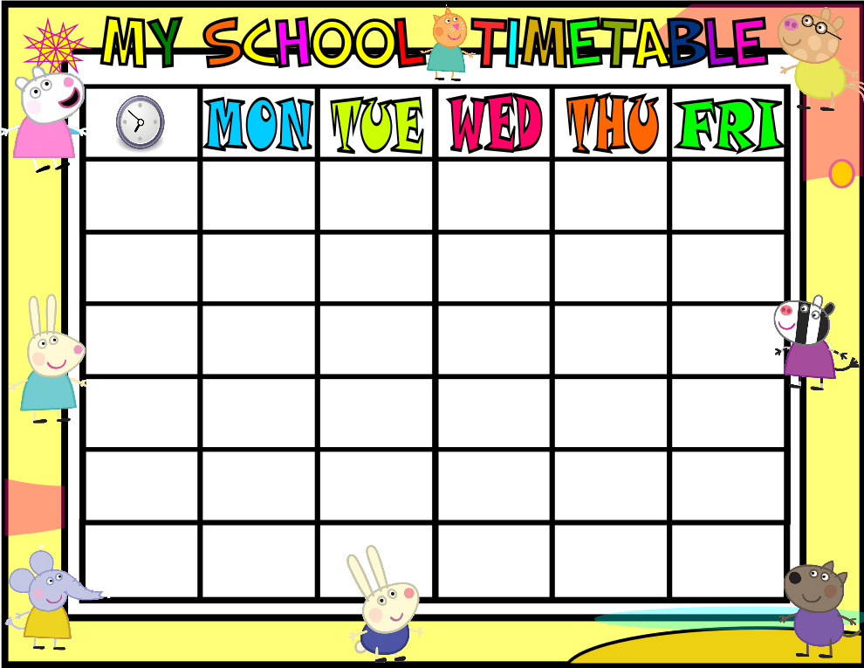
English
P.E.
English
P.E.
English
P.E.
When do we have P.E.?
We have P.E. on Thursday.
What do we have on Monday?
We have English.

Slide 26
Look and say.
+ What do we have on Tuesday?
=> We have …
+ When do we have …?
=> We have … on …
Pair work

Slide 27
It’s time for a game!
Notes:
Read the question
Click the timetable to have a look
Close the timetable
Answer the question
Click to check your answer!

Slide 28
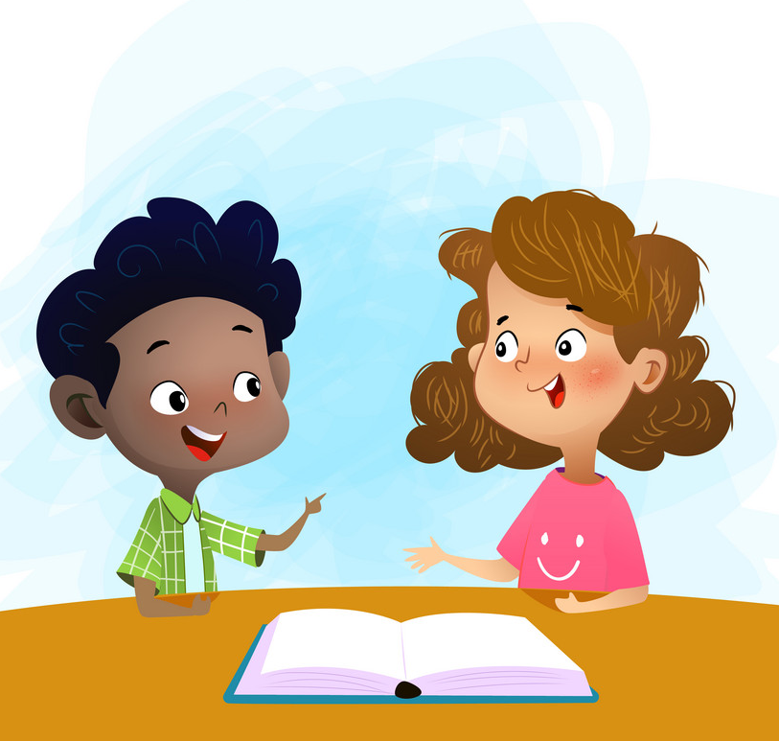
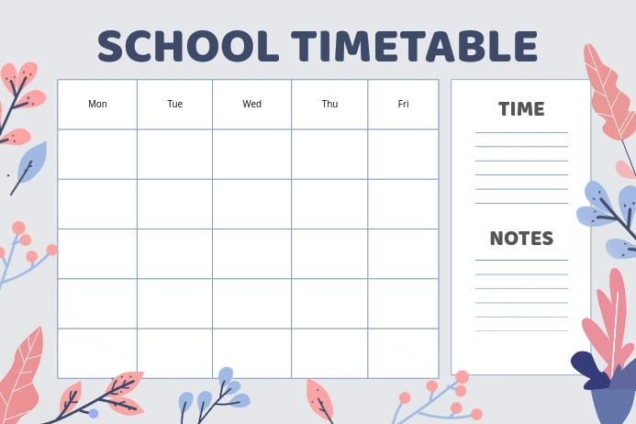
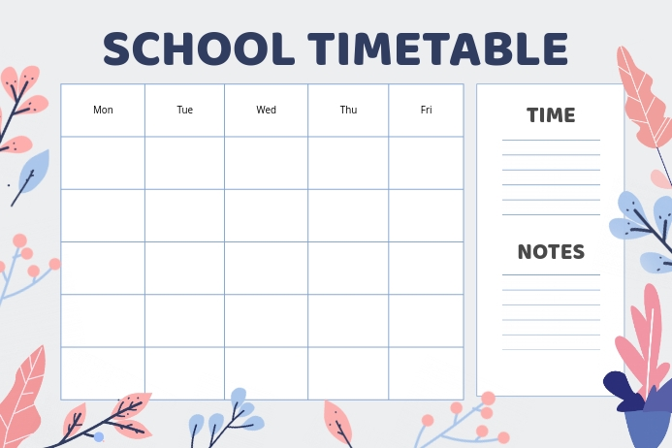
We have art on Monday and Friday.
When do we have art?

Slide 29
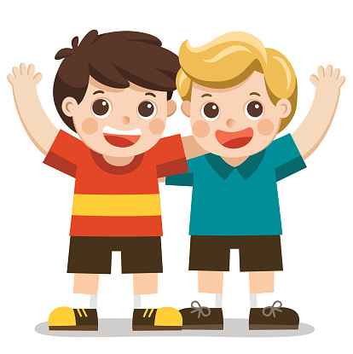
What do you have on Tuesday?
I have P.E and Math.

Slide 30
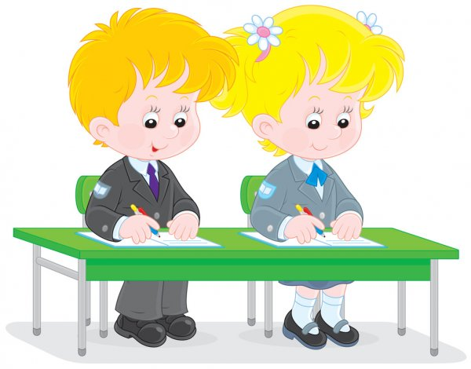
When do we have English?
We have English on Thursday.

Slide 31
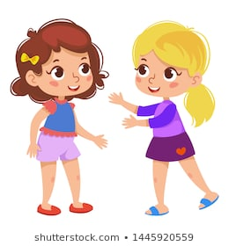
We have art and math on Friday.
What do we have on Friday?

Slide 32
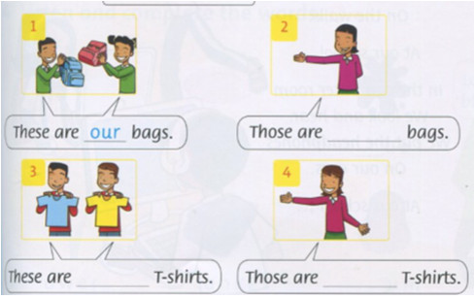
Write
Our/ their
their
our
their

Slide 33
Unit 4: We have English!
Grade 3
Lesson 3

Slide 34
Listen point and repeat!

Slide 36
Listen and sing

Slide 38
What to do?
Finish the exercises in your workbook!
page 28, 29, 30

